Slide 1



UNIT 6; The time of your life
Self-check 6

Slide 2
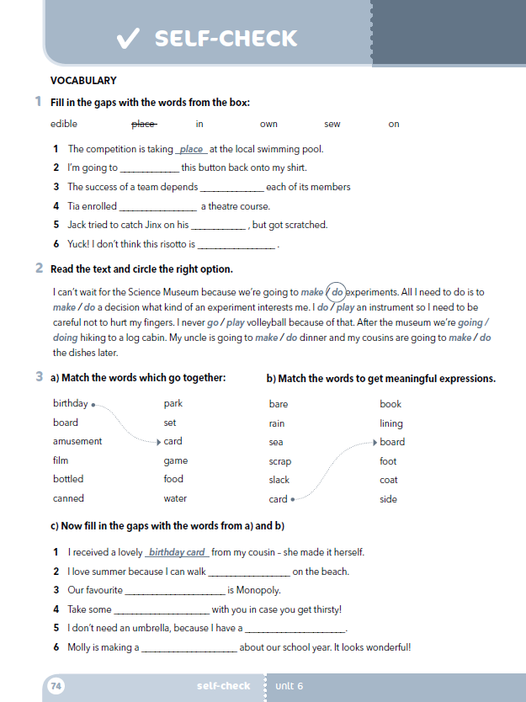
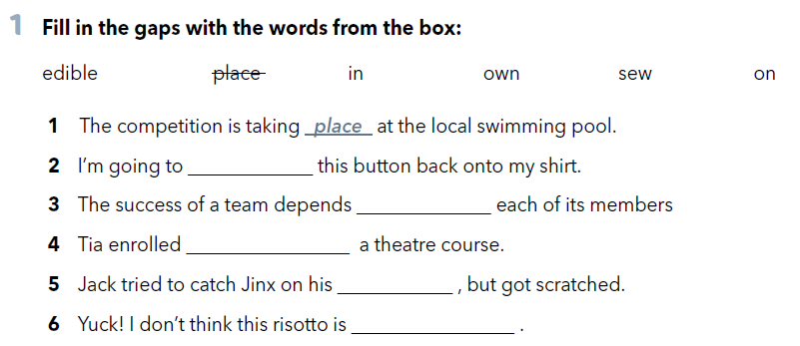
Workbook, p. 74
sew
on
in
own
edible

Slide 3
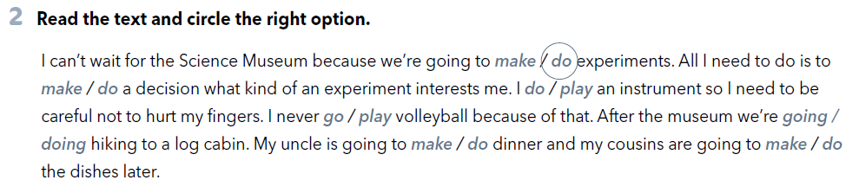


Slide 4
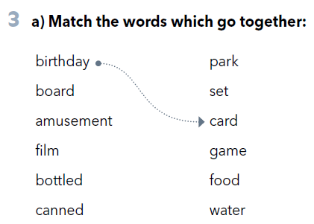
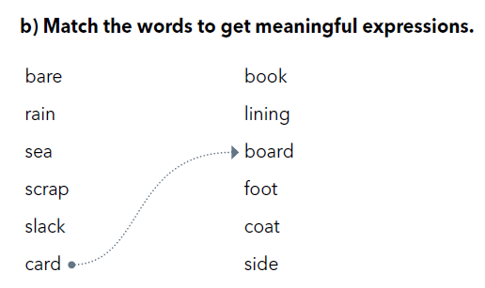

Slide 5
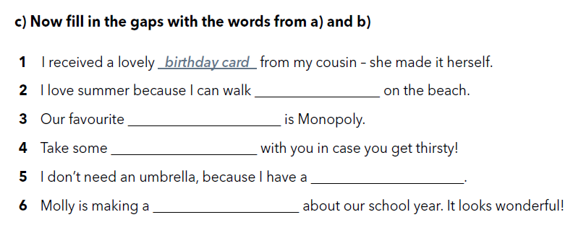
barefoot
boardgame
bottled water
raincoat
scrapbook

Slide 6
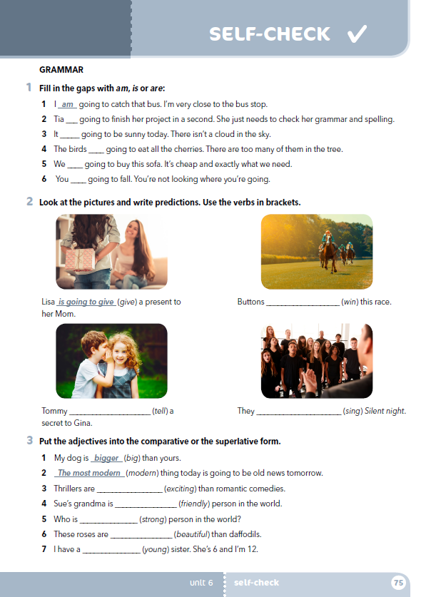
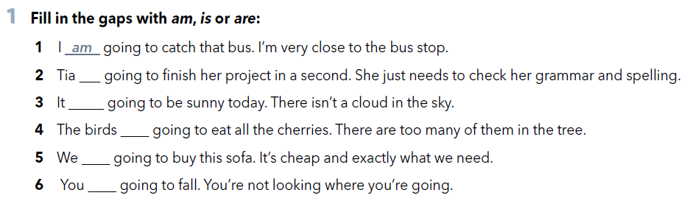
is
is
are
are
are

Slide 7
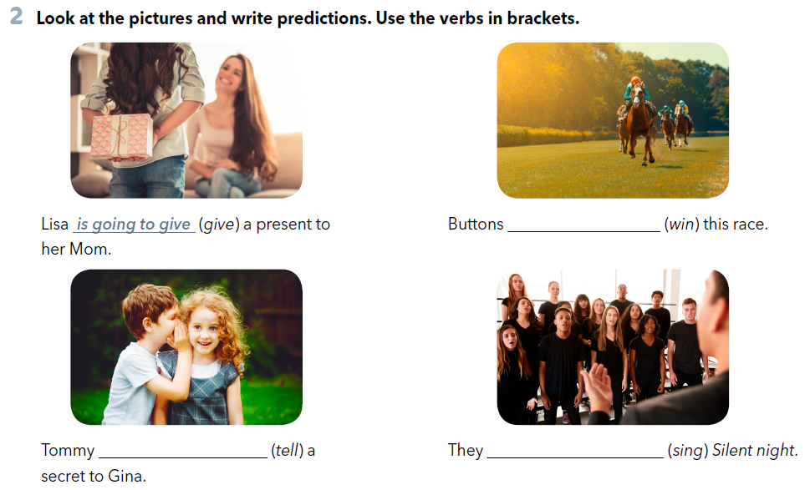
is going to win
is going to tell
are going to sing

Slide 8
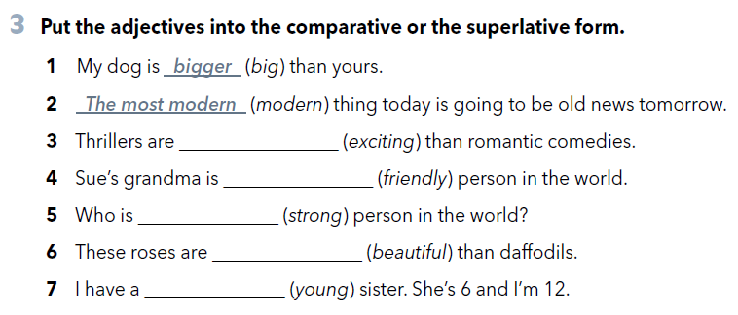
more exciting
the friendliest
the strongest
more beautiful
younger

Slide 9
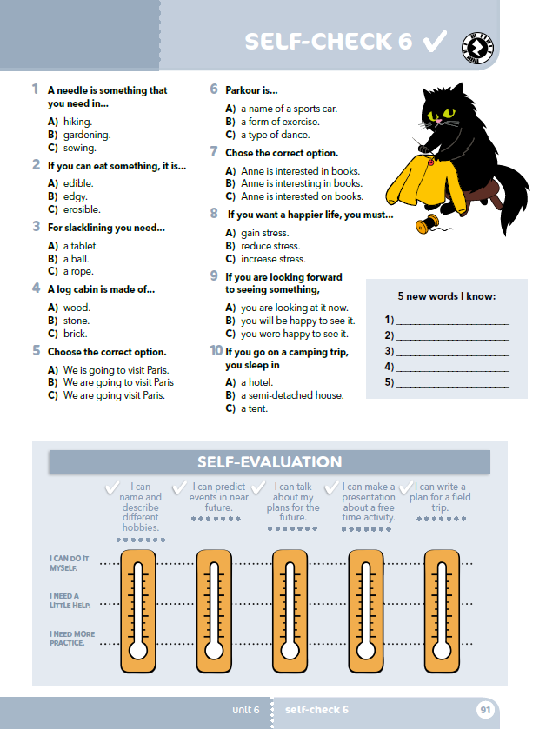
What kind of free time activities are most common with your classmates?
Can you name some dangerous activities?
How would you describe sewing toys / hiking as an activity?
How do you usually celebrate your birthday?
What are you going to do for your next birthday?
Would you like to have a birthday party outdoors?
What is easier – playing chess or doing Sudoku?

Slide 10
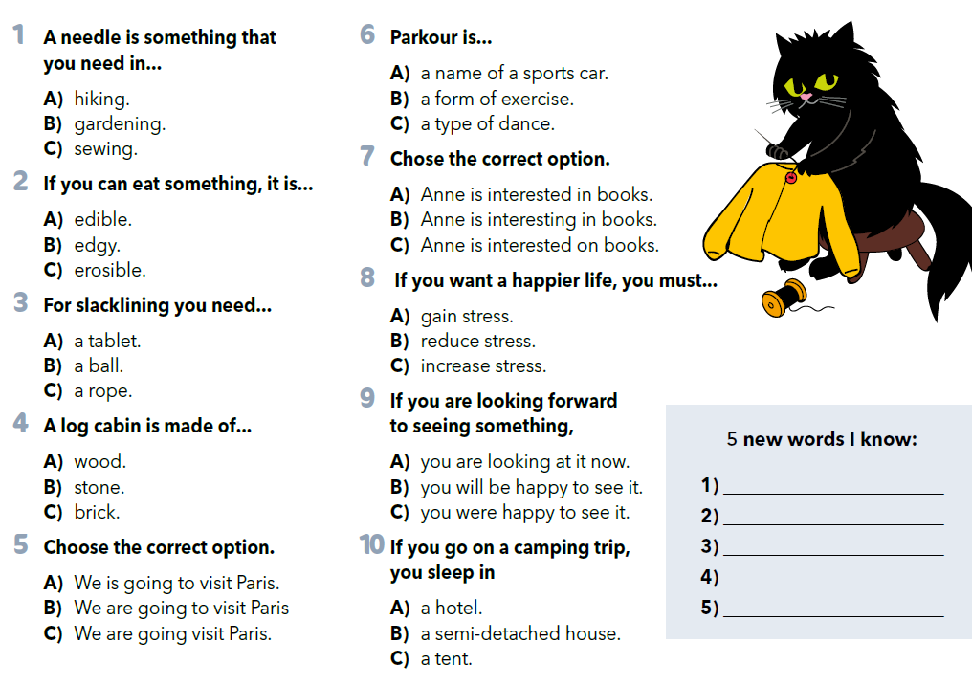

Write 5 new words you know. Zapiši pet novih riječi koje si naučio.
Let’s practise: https://wordwall.net/play/931/312/859

Slide 11
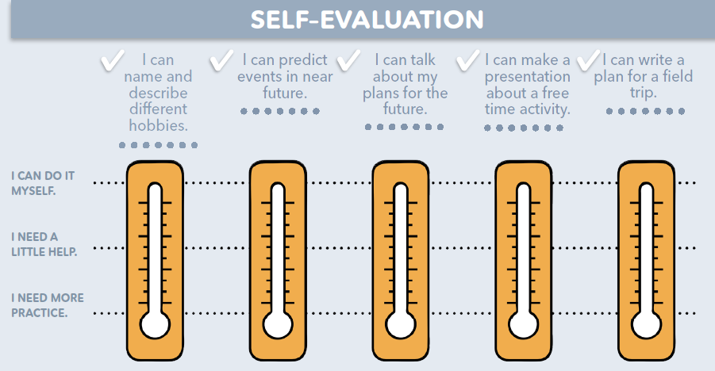
Na toplomjerima označi koliko su ti jasni sadržaji pete teme.
Možeš li imenovati i opisati različite hobije? Možeš li predvidjeti događaje u bliskoj budućnosti? Možeš li razgovarati o planovima za budućnost? Možeš li napraviti prezentaciju o aktivnosti za slobodno vrijeme? Možeš li napisati plan za izlet?
mogu sam, jasno mi je
trebam malo pomoći
moram još vježbati

